Slide 1


Dinara Kakisheva
2025-02-07

Slide 2

Outline
Executive Summary
Introduction
Methodology
Results
Conclusion
Appendix

Slide 3
Executive Summary
In this capstone project, we will predict if the SpaceX Falcon 9 first stage will land successfully using several machine learning classification algorithms.
The main steps in this project include:
Data collection, wrangling, and formatting
Exploratory data analysis
Interactive data visualization
Machine learning prediction
Our graphs show that some features of the rocket launches have a correlation with the outcome of the launches, i.e., success or failure.
It is also concluded that decision tree may be the best machine learning algorithm to predict if the Falcon 9 first stage will land successfully.

Slide 4
Introduction
In this capstone, we will predict if the Falcon 9 first stage will land successfully. SpaceX advertises Falcon 9 rocket launches on its website with a cost of 62 million dollars; other providers cost upward of 165 million dollars each, much of the savings is because SpaceX can reuse the first stage. Therefore if we can determine if the first stage will land, we can determine the cost of a launch. This information can be used if an alternate company wants to bid against SpaceX for a rocket launch.
Most unsuccessful landings are planned. Sometimes, SpaceX will perform a controlled landing in the ocean.
The main question that we are trying to answer is, for a given set of features about a Falcon 9 rocket launch which include its payload mass, orbit type, launch site, and so on, will the first stage of the rocket land successfully?

Slide 5

Section 1

Slide 6
Methodology
The overall methodology includes:
Data collection, wrangling, and formatting, using:
SpaceX API
Web scraping
Exploratory data analysis (EDA), using:
Pandas and NumPy
SQL
Data visualization, using:
Matplotlib and Seaborn
Folium
Dash
Machine learning prediction, using
Logistic regression
Support vector machine (SVM)
Decision tree
K-nearest neighbors (KNN)

Slide 7
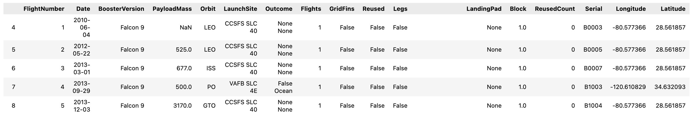
Data Collection – SpaceX API
The API used is https://api.spacexdata.com/v4/rockets/.
The API provides data about many types of rocket launches done by SpaceX, the data is therefore filtered to include only Falcon 9 launches.
Every missing value in the data is replaced the mean the column that the missing value belongs to.
We end up with 90 rows or instances and 17 columns or features. The picture below shows the first few rows of the data:

Slide 8

Data Collection – Web scraping
The data is scraped from https://en.wikipedia.org/w/index.php?title=List_of_Falcon_9_and_Falcon_Heavy_launches&oldid=1027686922
The website contains only the data about Falcon 9 launches.
We end up with 121 rows or instances and 11 columns or features. The picture below shows the first few rows of the data:

Slide 9
Data Wrangling
The data is later processed so that there are no missing entries and categorical features are encoded using one-hot encoding.
An extra column called ‘Class’ is also added to the data frame. The column ‘Class’ contains 0 if a given launch is failed and 1 if it is successful.
In the end, we end up with 90 rows or instances and 83 columns or features.

Slide 10
EDA
Pandas and NumPy
Functions from the Pandas and NumPy libraries are used to derive basic information about the data collected, which includes:
The number of launches on each launch site
The number of occurrence of each orbit
The number and occurrence of each mission outcome
SQL
The data is queried using SQL to answer several questions about the data such as:
The names of the unique launch sites in the space mission
The total payload mass carried by boosters launched by NASA (CRS)
The average payload mass carried by booster version F9 v1.1

Slide 11
Build an Interactive Map with Folium
Matplotlib and Seaborn
Functions from the Matplotlib and Seaborn libraries are used to visualize the data through scatterplots, bar charts, and line charts.
The plots and charts are used to understand more about the relationships between several features, such as:
The relationship between flight number and launch site
The relationship between payload mass and launch site
The relationship between success rate and orbit type
Folium
Functions from the Folium libraries are used to visualize the data through interactive maps.
The Folium library is used to:
Mark all launch sites on a map
Mark the succeeded launches and failed launches for each site on the map
Mark the distances between a launch site to its proximities such as the nearest city, railway, or highway

Slide 12
Build a Dashboard with Plotly Dash
Dash
Functions from Dash are used to generate an interactive site where we can toggle the input using a dropdown menu and a range slider.
Using a pie chart and a scatterplot, the interactive site shows:
The total success launches from each launch site
The correlation between payload mass and mission outcome (success or failure) for each launch site

Slide 13
Predictive Analysis (Classification)
Functions from the Scikit-learn library are used to create our machine learning models.
The machine learning prediction phase include the following steps:
Standardizing the data
Splitting the data into training and test data
Creating machine learning models, which include:
Logistic regression
Support vector machine (SVM)
Decision tree
K nearest neighbors (KNN)
Fit the models on the training set
Find the best combination of hyperparameters for each model
Evaluate the models based on their accuracy scores and confusion matrix

Slide 14
Results
The results are split into 5 sections:
SQL (EDA with SQL)
Matplotlib and Seaborn (EDA with Visualization)
Folium
Dash
Predictive Analysis
In all of the graphs that follow, class 0 represents a failed launch outcome while class 1 represents a successful launch outcome.

Slide 15

Section 2

Slide 16
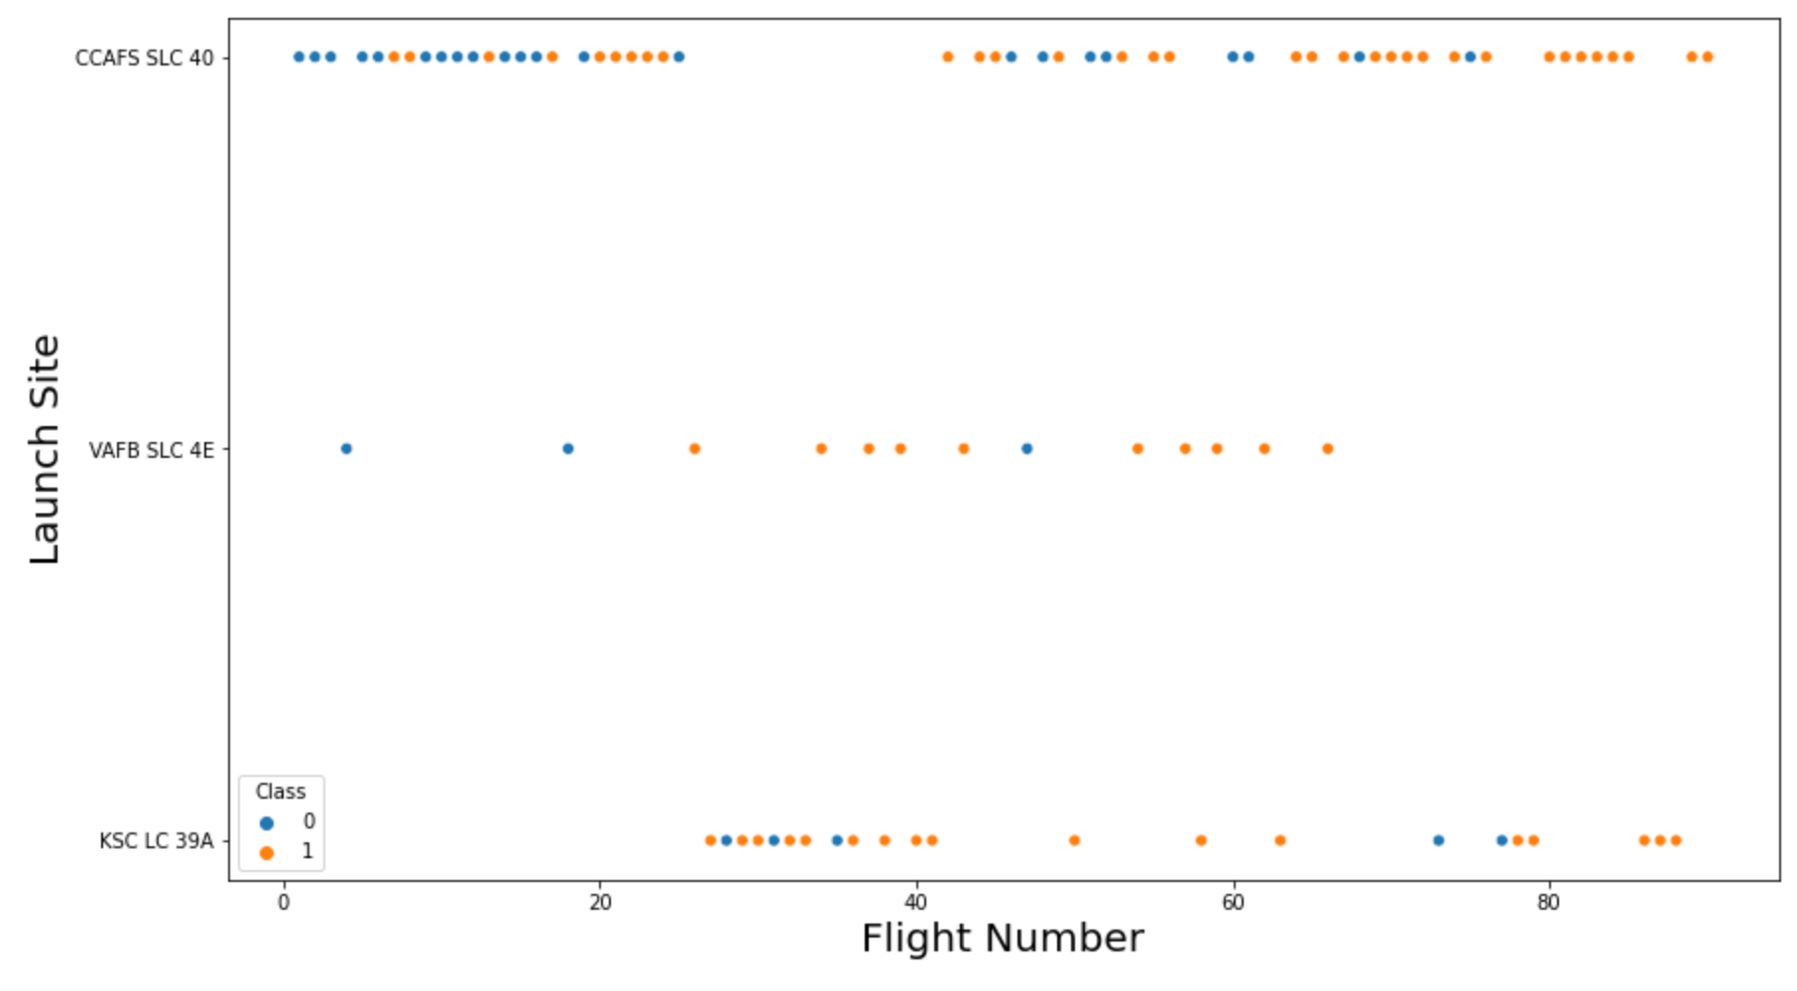
Flight Number vs. Launch Site
The relationship between flight number and launch site

Slide 17
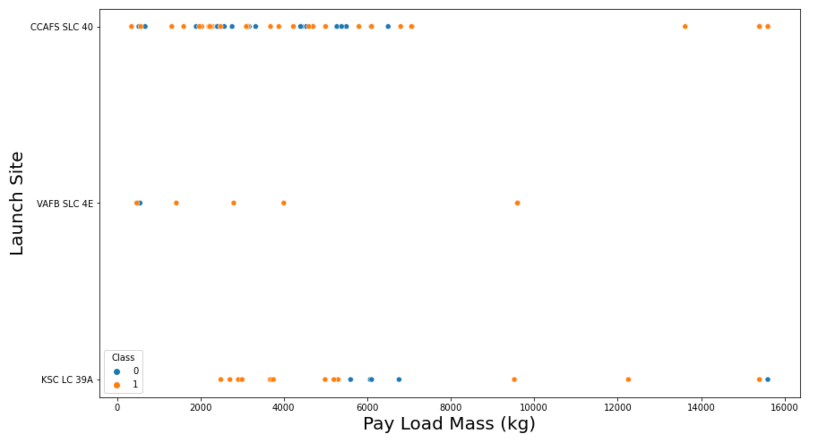
Payload vs. Launch Site
The relationship between payload mass and launch site

Slide 18
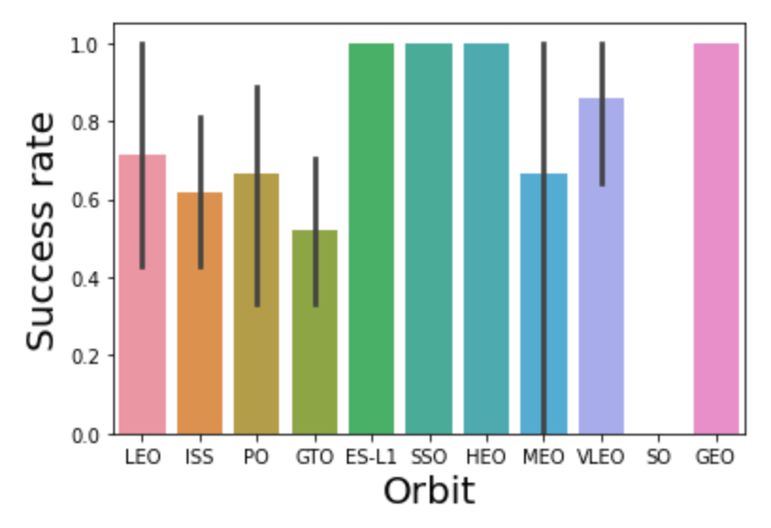
Success Rate vs. Orbit Type
The relationship between success rate and orbit type

Slide 19
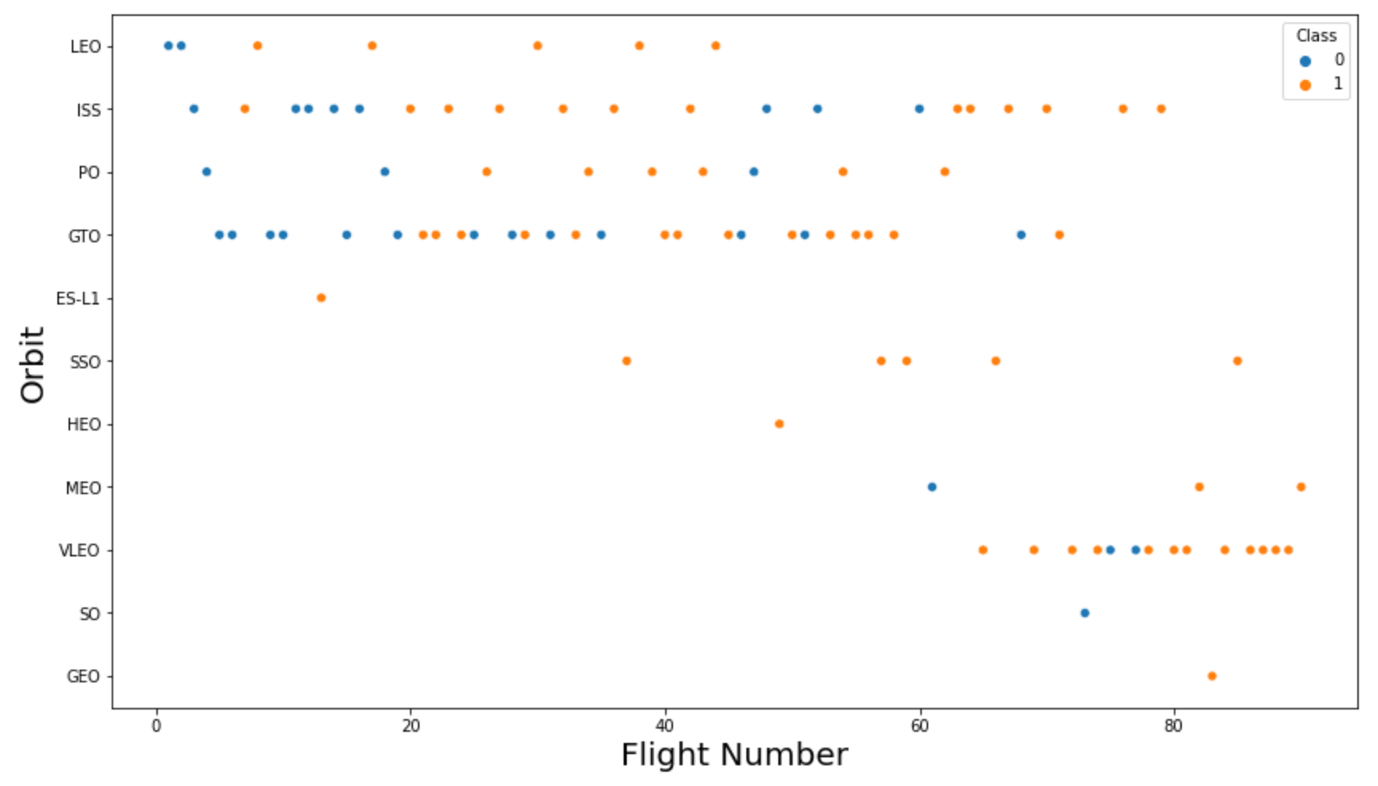
Flight Number vs. Orbit Type
The relationship between flight number and orbit type

Slide 20
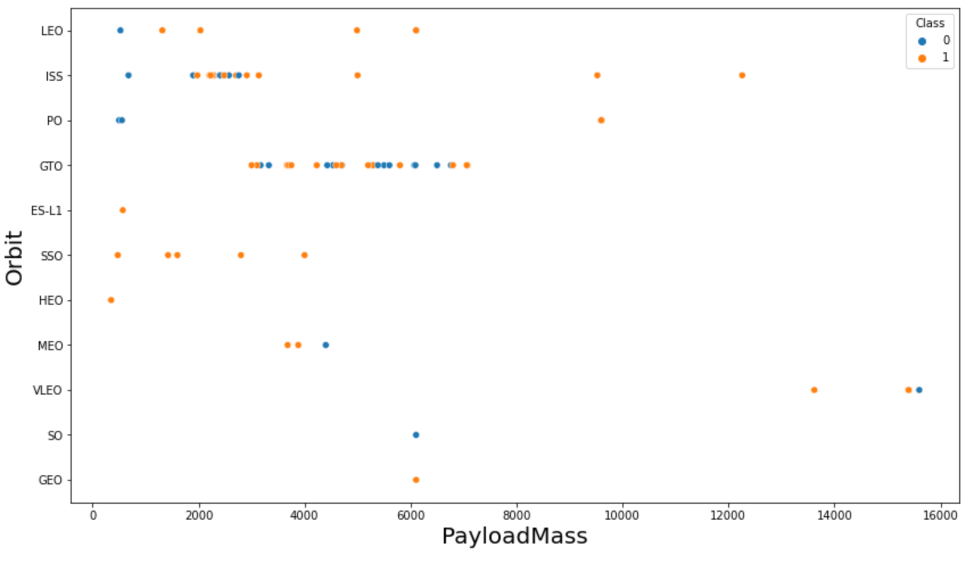
Payload vs. Orbit Type
The relationship between payload mass and orbit type

Slide 21
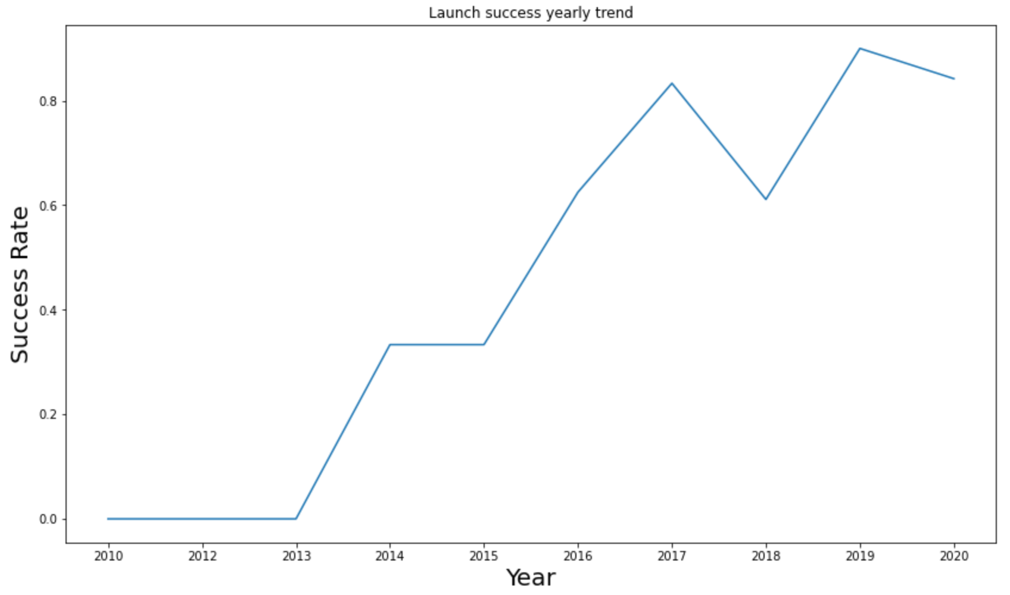
Launch Success Yearly Trend
The launch success yearly trend

Slide 22
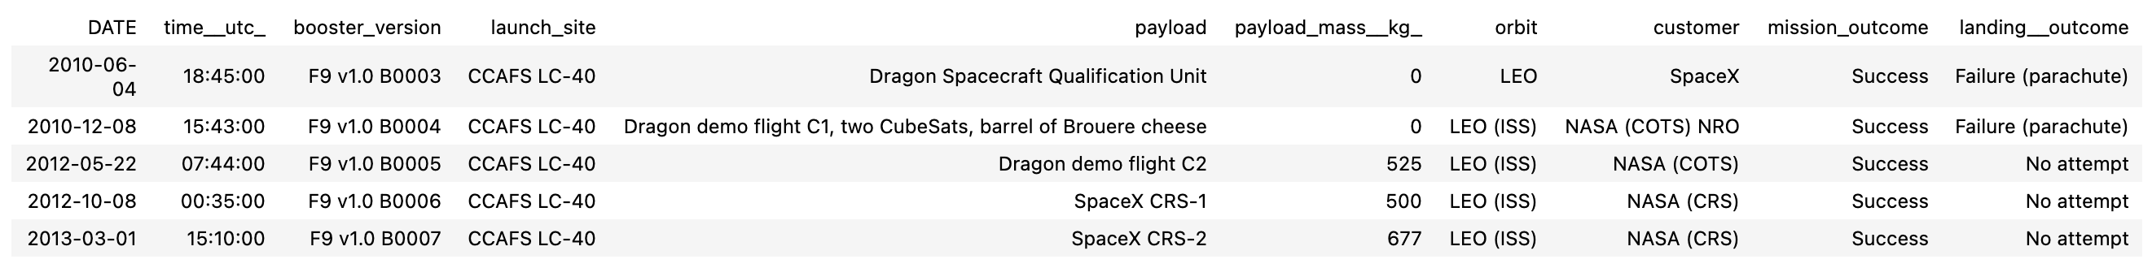
All Launch Site Names
The names of the unique launch sites in the space mission

Slide 23
Launch Site Names Begin with 'CCA'
5 records where launch sites begin with ‘CCA’

Slide 24
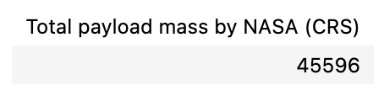
Total Payload Mass
The total payload mass carried by boosters launched by NASA (CRS)

Slide 25
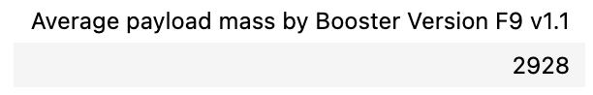
Average Payload Mass by F9 v1.1
The average payload mass carried by booster version F9 v1.1

Slide 26
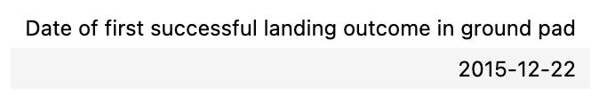
First Successful Ground Landing Date
The date when the first successful landing outcome in ground pad was achieved

Slide 27
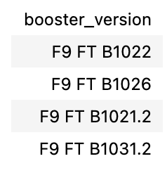
Successful Drone Ship Landing with Payload between 4000 and 6000
The names of the boosters which have success in drone ship and have payload mass greater than 4000 but less than 6000

Slide 28
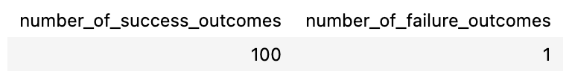
Total Number of Successful and Failure Mission Outcomes
The total number of successful and failure mission outcomes

Slide 29
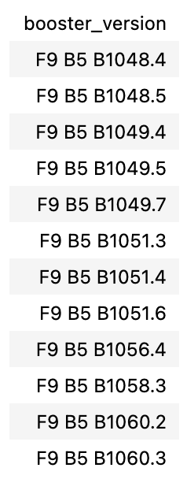
Boosters Carried Maximum Payload
The names of the booster versions which have carried the maximum payload mass

Slide 30
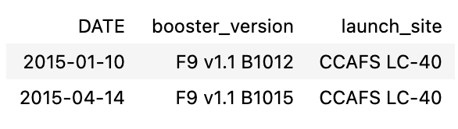
2015 Launch Records
The failed landing outcomes in drone ship, their booster versions, and launch site names for in year 2015

Slide 31
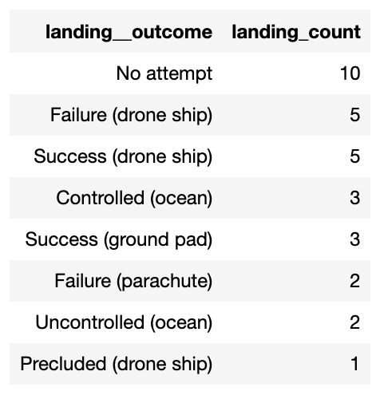
Rank Landing Outcomes Between 2010-06-04 and 2017-03-20
The count of landing outcomes between the date 2010-06-04 and 2017-03-20, in descending order

Slide 32

Section 3

Slide 33

Folium Map #1
All launch sites on map

Slide 34
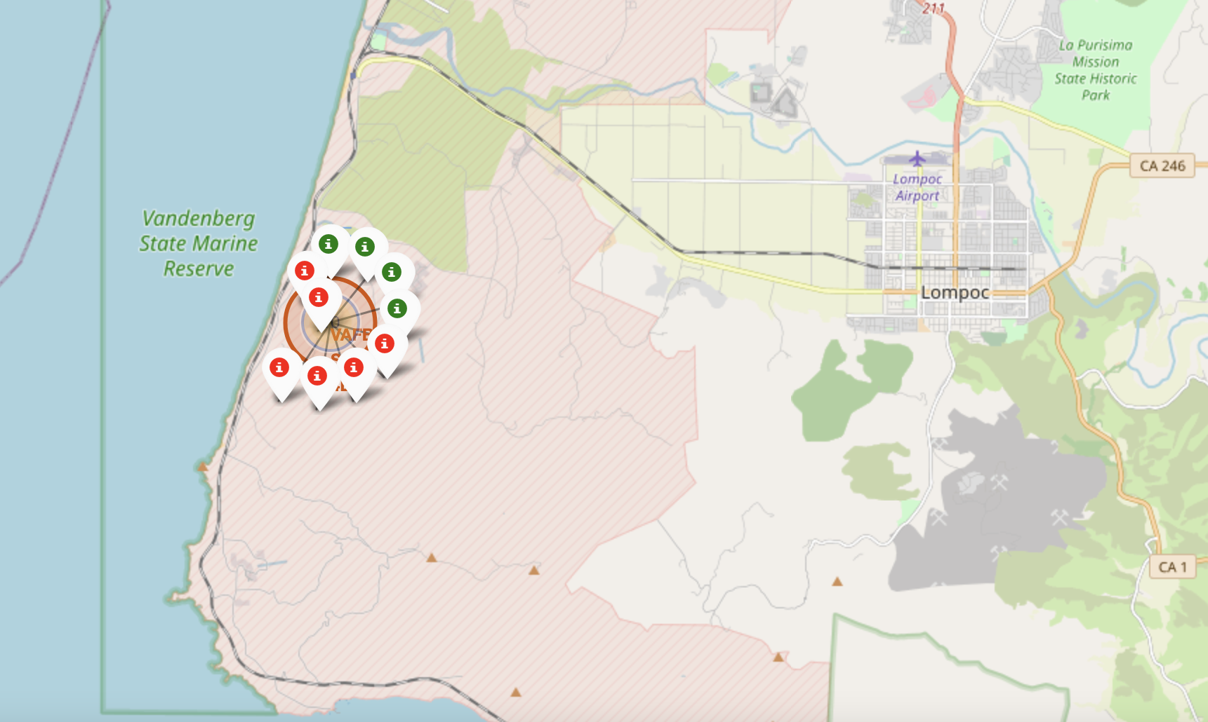
Folium Map #2
The succeeded launches and failed launches for each site on map
If we zoom in on one of the launch site, we can see green and red tags. Each green tag represents a successful launch while each red tag represents a failed launch

Slide 35
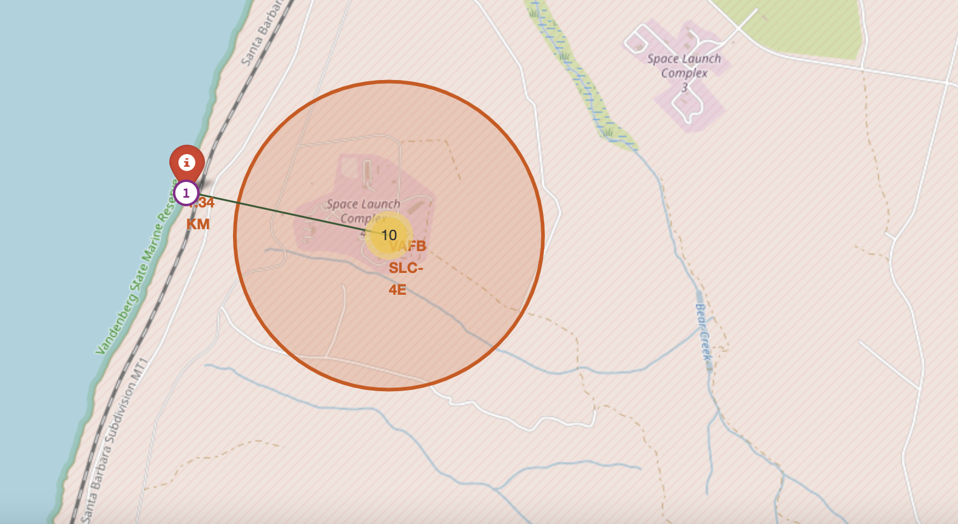
Folium Map #3
The distances between a launch site to its proximities such as the nearest city, railway, or highway
The picture below shows the distance between the VAFB SLC-4E launch site and the nearest coastline

Slide 36

Section 4

Slide 37

Dashboard Screenshot 1
The picture below shows a pie chart when launch site CCAFS LC-40 is chosen.
0 represents failed launches while 1 represents successful launches. We can see that 73.1% of launches done at CCAFS LC-40 are failed launches.

Slide 38
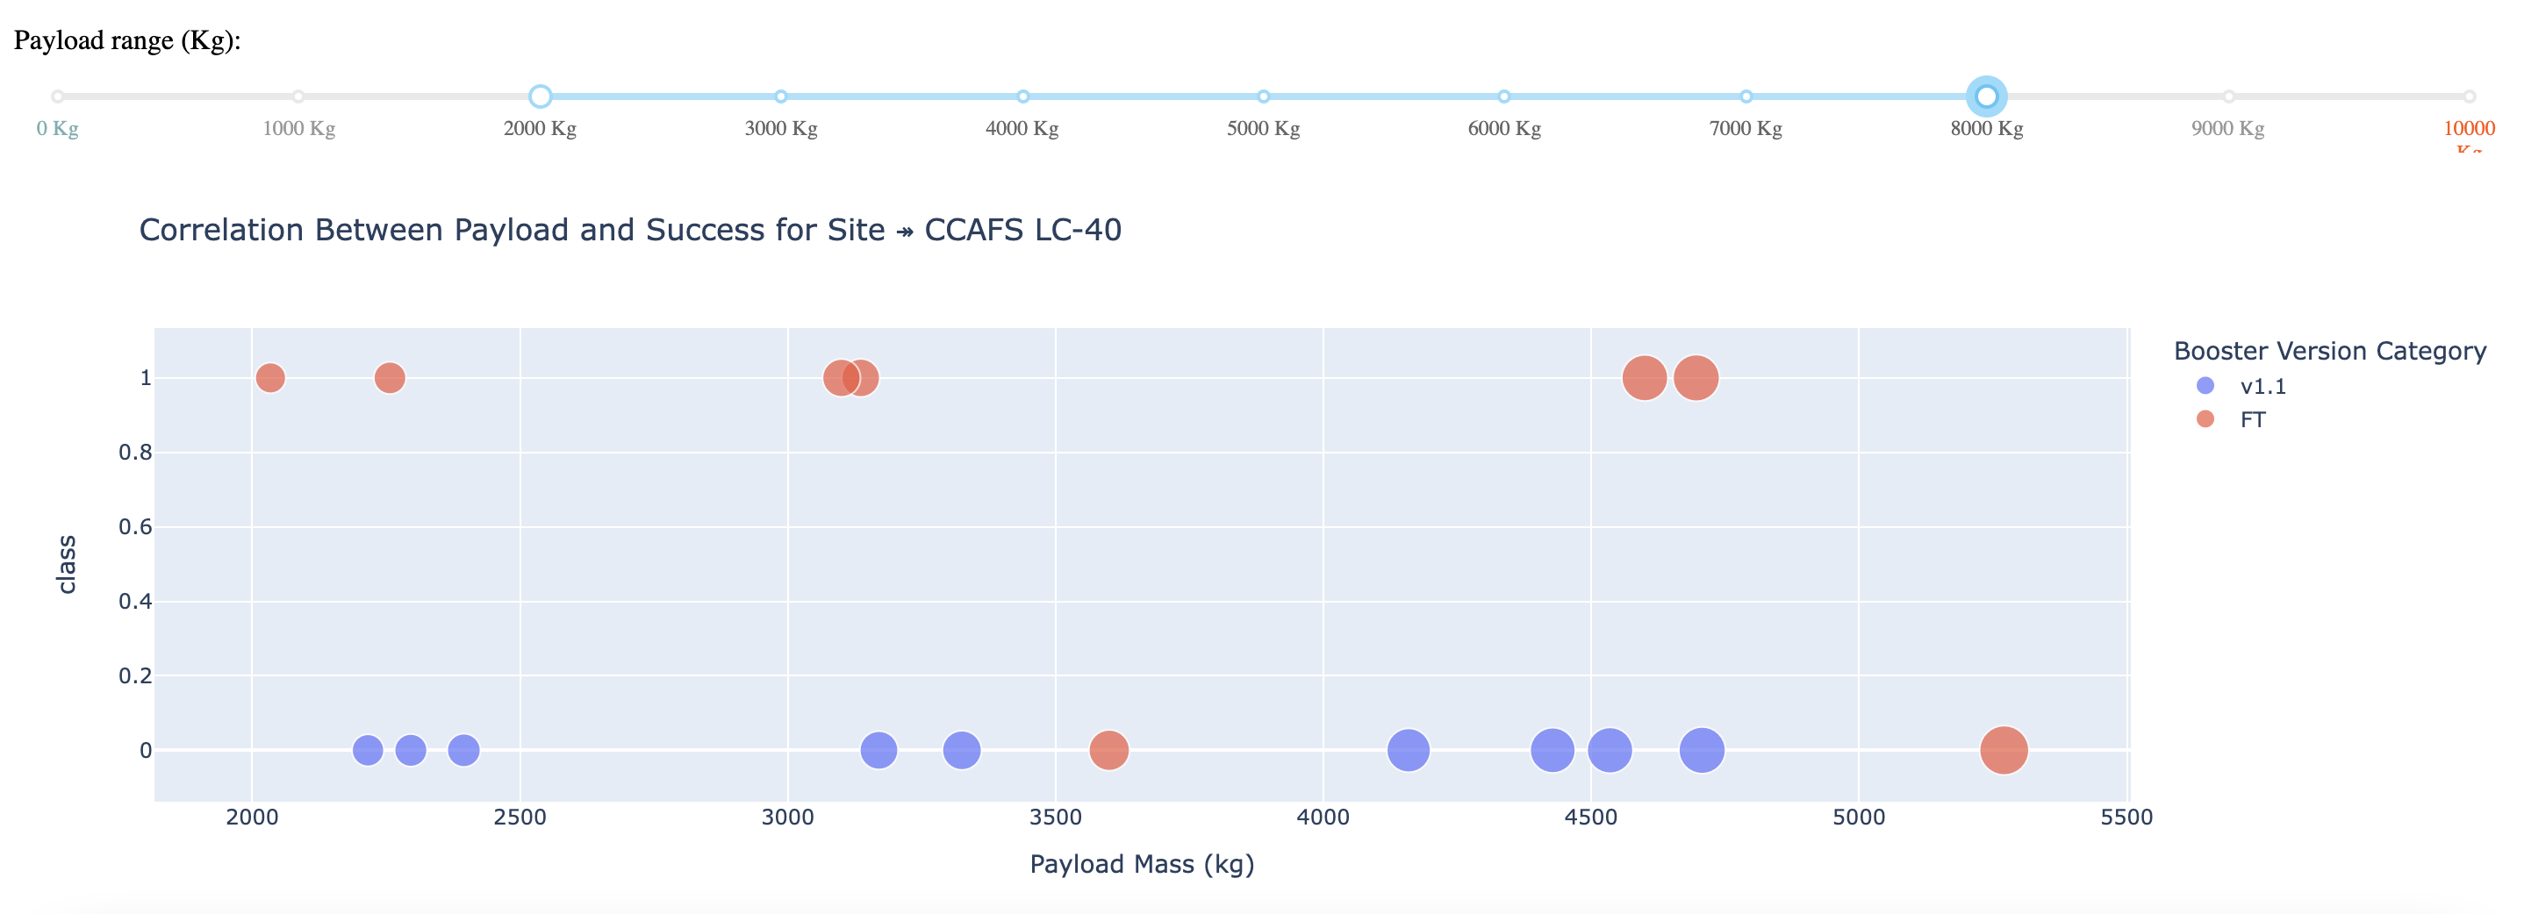
Dashboard Screenshot 2
The picture below shows a pie chart when launch site CCAFS LC-40 is chosen.
0 represents failed launches while 1 represents successful launches. We can see that 73.1% of launches done at CCAFS LC-40 are failed launches.

Slide 39
Dashboard Screenshot 3
The picture below shows a scatterplot when the payload mass range is set to be from 2000kg to 8000kg.
Launch outcome 0 represents failed launches while launch outcome 1 represents successful launches.

Slide 40

Section 5

Slide 41

Classification Accuracy
Logistic regression
GridSearchCV best score: 0.8464285714285713
Accuracy score on test set: 0.8333333333333334
Support vector machine (SVM)
GridSearchCV best score: 0.8482142857142856
Accuracy score on test set: 0.8333333333333334
Decision tree
GridSearchCV best score: 0.8892857142857142
Accuracy score on test set: 0.8333333333333334
K nearest neighbors (KNN)
GridSearchCV best score: 0.8482142857142858
Accuracy score on test set: 0.8333333333333334

Slide 42
Confusion Matrix
Putting the results of all 4 models side by side, we can see that they all share the same accuracy score and confusion matrix when tested on the test set.
Therefore, their GridSearchCV best scores are used to rank them instead. Based on the GridSearchCV best scores, the models are ranked in the following order with the first being the best and the last one being the worst:
Decision tree (GridSearchCV best score: 0.8892857142857142)
K nearest neighbors, KNN (GridSearchCV best score: 0.8482142857142858)
Support vector machine, SVM (GridSearchCV best score: 0.8482142857142856)
Logistic regression (GridSearchCV best score: 0.8464285714285713)

Slide 43
Conclusions
In this project, we try to predict if the first stage of a given Falcon 9 launch will land in order to determine the cost of a launch.
Each feature of a Falcon 9 launch, such as its payload mass or orbit type, may affect the mission outcome in a certain way.
Several machine learning algorithms are employed to learn the patterns of past Falcon 9 launch data to produce predictive models that can be used to predict the outcome of a Falcon 9 launch.
The predictive model produced by decision tree algorithm performed the best among the 4 machine learning algorithms employed.

Slide 44


